Slide 1
BFX-UH300 (K18X001.00) No sound During Google Setup Wirazd Report
Prepared by: PE – Do Thi Phuong
Date: June 02th 2022

Slide 2
D1. Establish the Team
Team Leader
Team Member
PE: Michael, Phuong
ME: Cheng Lun, Wen Thai
PM: Ben Zheng, An Tran
PD: Ruan Wen Yong
QA: Ken, Rachel
TE: Mark Wu, Allan Pham
IE: Hai Ly, Heng Ruan
Foxconn
  MFG Director: David Yin
  QA Manager : CB Lin, Toney

Slide 3
D2. Description of Problems
Issue Description
On 05/05/2022, ALT customer complaint 1pcs no sound during Google setup wirazd and customer measure abnormal at J806_Pin 6_AUX port.
Failure status: Plug power supply 24V/4A no sound during Google setup wirazd
Failure information :
Fox_SN | Cus_SN | MAC | TEST TIME | ERROR CAUSE
YW70U70 | 2149695001202109002264 | A8934AFE7F26 | 11/2021 | No sound during Google setup wirazd

Slide 4
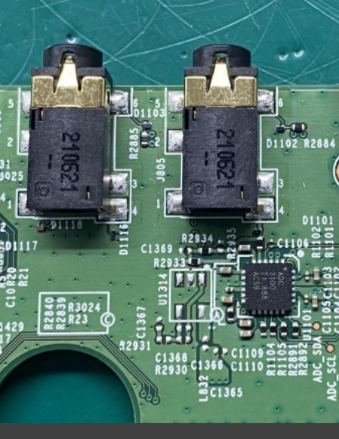
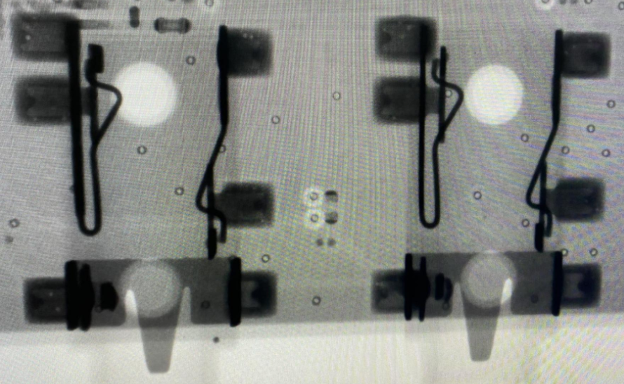
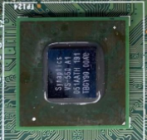
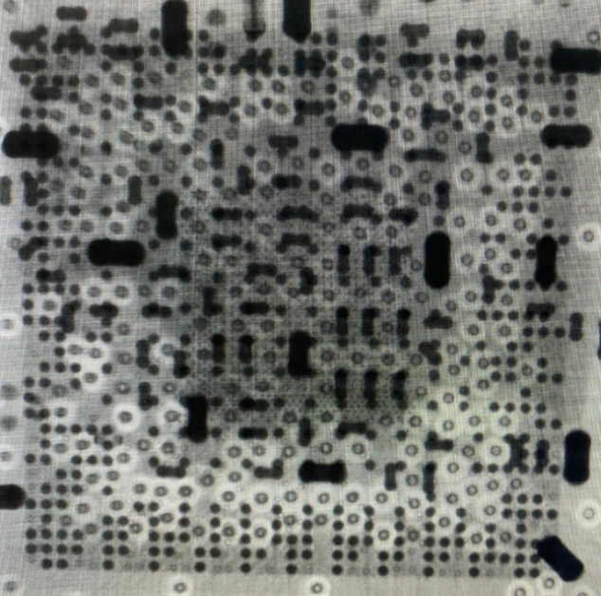
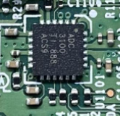
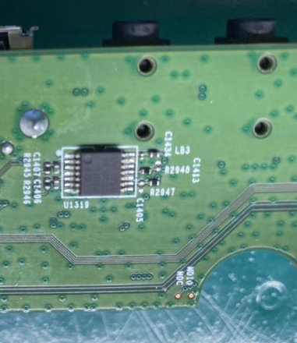
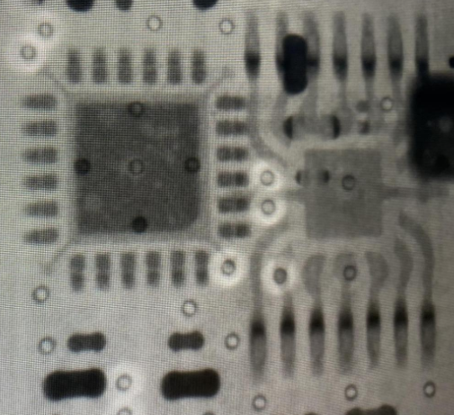
D3: Containment
1.Product checking, Baking, Take X-ray and VI PCBA
1. Reset SKB and check sound during Google setup wizard ➔ No sound
2. Baking PCBA with 70ºC in 24 hours.
3. Recheck sound during Google setup wizard → Still no sound.
4. Take X-ray and VI PCBA focus on AUX, MIC block → Did not find out any abnormality.
AUX and MIC port
SoC(U1)
U1101, U1319

Slide 5
D3. Containment
Check FATP and OBA record data
FATP: NG prouduct tested pass at FATP
OBA: Product wasn’t tested at OBA station
Note: OBA station only test AQL: 0.65
SERIAL_NUMBER | MO_NUMBER | GROUP_NAME | IN_STATION_TIME | WIP_GROUP
A8934AFE7F26 | 2639001581 | ASSY | 11/5/2021 2:37:47 AM | BT
A8934AFE7F26 | 2639001581 | BT | 11/5/2021 3:35:25 AM | PT
A8934AFE7F26 | 2639001581 | PT | 11/8/2021 3:57:00 PM | UP
A8934AFE7F26 | 2639001581 | UP | 11/8/2021 4:00:32 PM | ASSY2
A8934AFE7F26 | 2639001581 | ASSY2 | 11/9/2021 2:52:43 PM | ASSY3
A8934AFE7F26 | 2639001581 | ASSY3 | 11/9/2021 2:57:08 PM | ASSY4
A8934AFE7F26 | 2639001581 | ASSY4 | 11/9/2021 2:59:14 PM | FT1
A8934AFE7F26 | 2639001581 | FT1 | 11/9/2021 4:59:53 PM | FT2
A8934AFE7F26 | 2639001581 | FT2 | 11/9/2021 5:06:34 PM | FT3
A8934AFE7F26 | 2639001581 | FT3 | 11/9/2021 5:10:00 PM | RC
A8934AFE7F26 | 2639001581 | RC | 11/9/2021 5:11:53 PM | RC1
A8934AFE7F26 | 2639001581 | RC1 | 11/9/2021 7:31:17 PM | VI
A8934AFE7F26 | 2639001581 | VI | 11/10/2021 3:50:28 AM | RC2
A8934AFE7F26 | 2639001581 | RC2 | 11/10/2021 3:52:58 AM | VI1
A8934AFE7F26 | 2639001581 | VI1 | 11/10/2021 3:58:34 AM | PACK_BOX
A8934AFE7F26 | 2639001581 | PACK_BOX | 11/10/2021 4:00:06 AM | CHECK_WEIGHT
A8934AFE7F26 | 2639001581 | CHECK_WEIGHT | 11/10/2021 4:19:14 AM | PACK_CTN
A8934AFE7F26 | 2639001581 | PACK_CTN | 11/10/2021 1:46:10 PM | PACK_PALT
A8934AFE7F26 | 2639001581 | PACK_PALT | 11/10/2021 3:46:12 PM | FQA
A8934AFE7F26 | 2639001581 | FQA | 11/10/2021 3:49:39 PM | CHK_PALT
A8934AFE7F26 | 2639001581 | STOCKIN | 11/10/2021 4:21:02 PM | FG

Slide 6
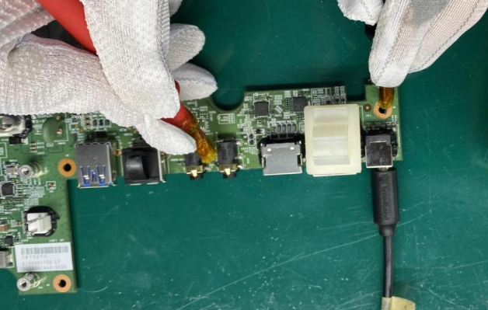
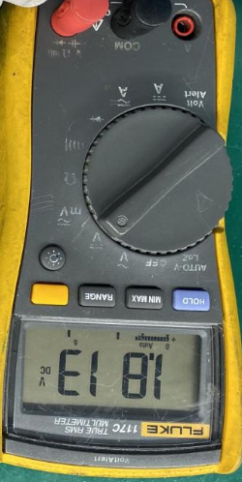
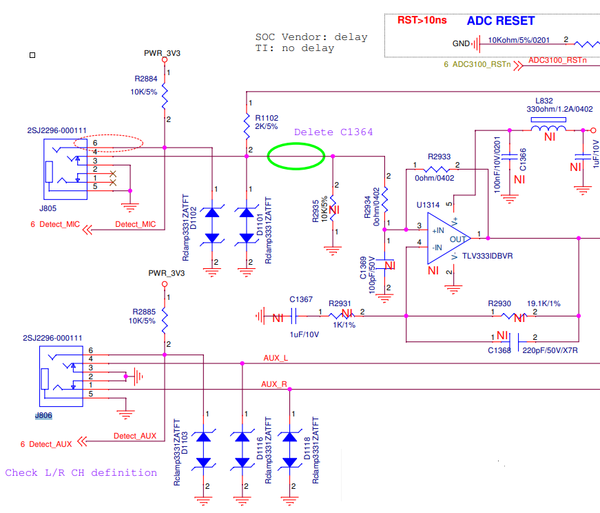
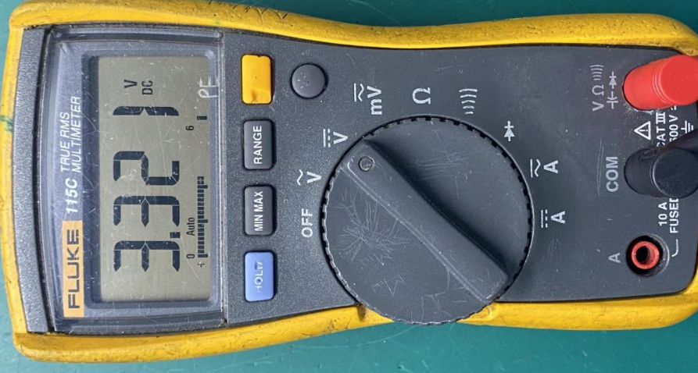
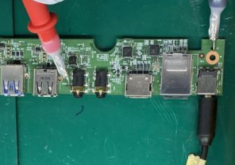
D4. Root Cause
1. Check AUX, MIC port on main board
Check voltage at AUX, MIC port
- Measure voltage at J806_pin 6, J805_pin 6 of NG product find out abnormal is 1.901V ( With OK product is 3.3V)
OK sample
NG sample
Check voltage at J806_pin6_AUX port
OK sample
NG sample
Check voltage at J805_pin6_MIC port
Circuit diagram of AUX, MIC port
Summary:
- Voltage at J806_pin 6, J805_pin 6 of NG product has abnormal

Slide 7
D4. Root Cause
2. Check AUX, MIC port on main board
Check impedance, voltage diode on AUX, MIC port
- Measure impedance and voltage diode of J806_AUX port and J805_MIC port
J806_Pin number | OK sample |  | NG sample |  | Result
 | Impedance(ohm) | Voltage diode(VDC) | Impedance(ohm) | Voltage diode(VDC)
1_AUX_R | 0.6 | 0 | 0.6 | 0 | Normal
2_GND | 0.6 | 0 | 0.6 | 0 | Normal
3_GND | 0.6 | 0 | 0.6 | 0 | Normal
4_ AUX_L | 0.6 | 0 | 0.6 | 0 | Normal
5_GND | 0.6 | 0 | 0.6 | 0 | Normal
6_Detect_AUX | 14.11K | 0.566 | 14.18K | 0.534 | Normal
J805_Pin number | OK sample |  | NG sample |  | Result
 | Impedance(ohm) | Voltage diode(VDC) | Impedance (ohm) | Voltage diode(VDC)
1 | ∞ | ∞ | ∞ | ∞ | Normal
2 | ∞ | ∞ | ∞ | ∞ | Normal
3_GND | 0.6 | 0 | 0.6 | 0 | Normal
4_MIC_L | 0.6 | 0 | 0.6 | 0 | Normal
5_GND | 0.6 | 0 | 0.6 | 0 | Normal
6_Detect_MIC | 14.18K | 0.578 | 14.09K | 0.534 | Normal
Summary:
- J806, J805 check impedance and voltage diode normally

Slide 8
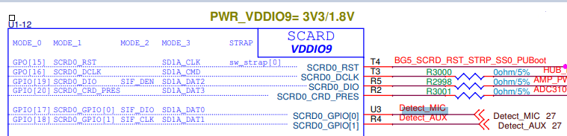
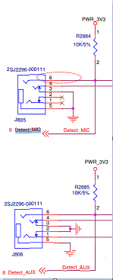
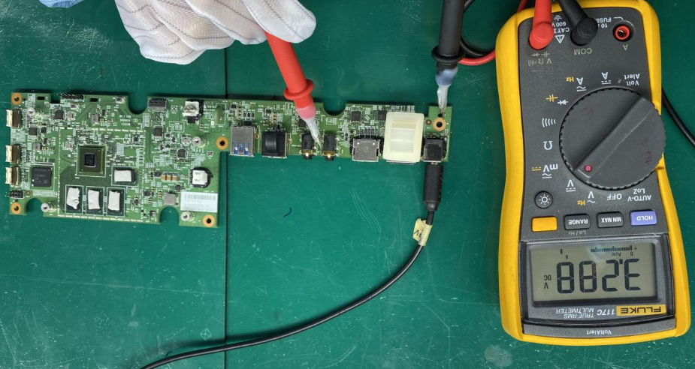
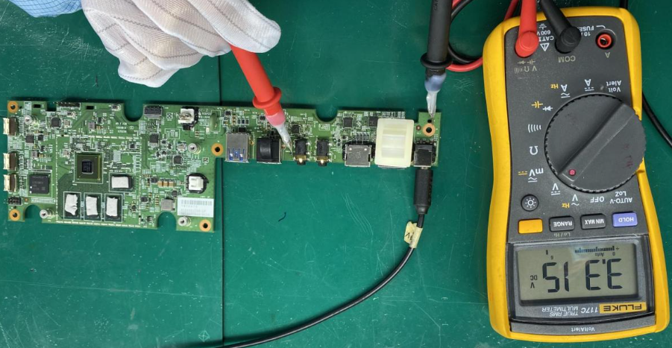
D4. Root Cause
3. Change new SoC, eMMC
Remark: the Detect_AUX, detect_MIC signal connect from U1_SoC to J806_pin 6 and J805_pin 6
- After measure at J806, J805 find out voltage abnormal ➔ Suspect detect_AUX, detect_MIC signal has problem
➔ Changed new SoC, eMMC then check voltage at J806_pin 6 and J805_pin 6 ➔ NG board normally
Check voltage at J806_pin 6_AUX port on main board
Circuit diagram of detect_AUX, detect_MIC signal
Check voltage at J805_pin 6_MIC port on main board
Summary:
- After change new SoC, eMMC, NG product has 3.3V at J806_pin 6 and J805_pin 6 normal.

Slide 9
D4. Root Cause
4. Measure impedance and voltage diode SoC_U1 of NG board
- Removed SoC_U1 then check impedance and voltage diode of 2 pins detect _AUX, detect _MIC ➔ No abnormalities found
No# | Pin Name | Pin Description | SoC_U1 OK sample |  | SoC_U1 NG sample
 |  |  | Impedance (Ω) | VF voltage (VD) | Impedance (Ω) | VF voltage (VD)
1 | Pin U3_SCRD0_GPIO[0] | Detect MIC | 2..205M | 0.709 | 2.158M | 0.703
2 | Pin R4_SCRD0_GPIO[1] | Detect AUX | 2.085M | 0.709 | 2.060M | 0.703
Summary:
- Check impedance and voltage diode normally

Slide 10
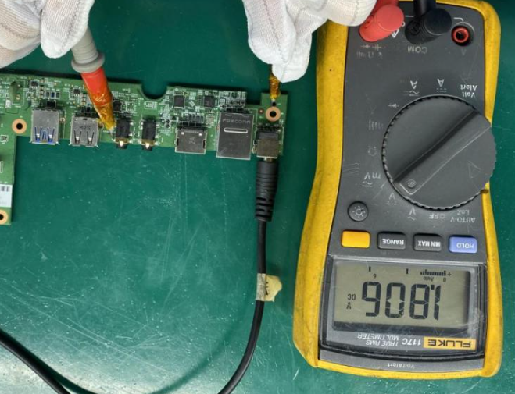
D4. Root Cause
5. SoC, eMMC Swap Verification
- Swap verification (SoC+eMMC) of NG board, received result as table.
Item | Result
OK board + OK (SoC, eMMC) | OK
NG board + NG(SoC, eMMC) | NG
OK board + NG(SoC, eMMC) | NG
NG broad + OK (SoC, eMMC) | OK
Check voltage at J805_pin 6_MIC port( OK board+ NG SoC,eMMC)
Summary:
- As analysis above this issue follow U1_SoC and U6_eMMC component.

Slide 11
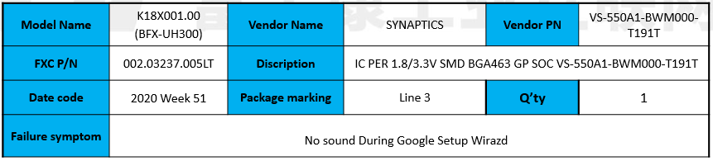
Conclusion
1. Summary for root cause
Root cause:
As analysis above this issue follow (SoC_U1) component
Action:
- Need SQE send SoC to SYNAPTICS verdor for further analysis. Due date: 2022/06/05

